Slide 1
UNIT IV
RELATIONAL ALGEBRA

Slide 2
Relation Schema
A₁, A₂, …, A_{n} are attributes
R = (A₁, A₂, …, A_{n} ) is a relation schema
E.g. Customer-schema =
(customer-name, customer-street, customer-city)
r(R) is a relation on the relation schema R
E.g. customer (Customer-schema)

Slide 3
Relation Instance
The current values (relation instance) of a relation are specified by a table
An element t of r is a tuple, represented by a row in a table
attributes
(or columns)
customer-name
customer-street
customer-city
Jones
Smith
Curry
Lindsay
Main
North
North
Park
Harrison
Rye
Rye
Pittsfield
tuples
(or rows)
customer

Slide 4
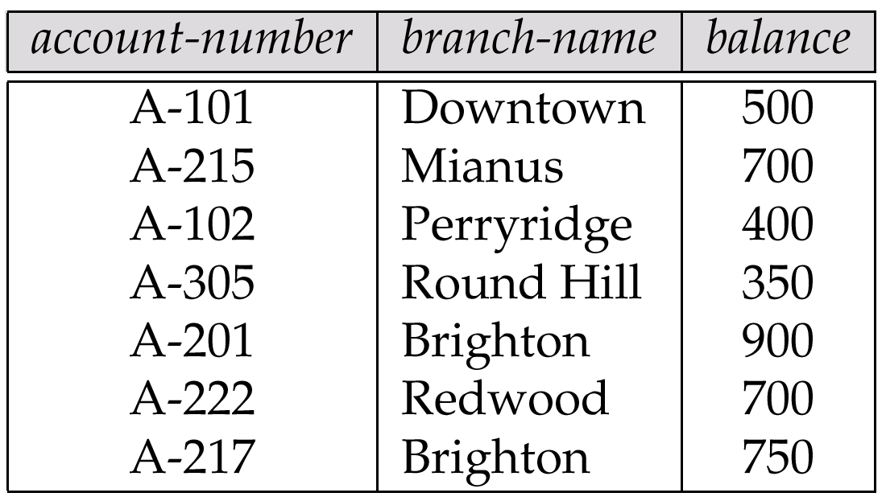
Relations are Unordered
Order of tuples is irrelevant (tuples may be stored in an arbitrary order)
E.g. account relation with unordered tuples

Slide 5

The customer Relation

Slide 6

The depositor Relation

Slide 7
Query Languages
Language in which user requests information from the database.
Categories of languages
  procedural
  non-procedural
“Pure” languages:
  Relational Algebra
  Tuple Relational Calculus
  Domain Relational Calculus
Pure languages form underlying basis of query languages that people use.

Slide 8
Relational Algebra
Procedural language
Six basic operators
  select
  project
  union
  set difference
  Cartesian product
  rename
The operators take one or more relations as inputs and give a new relation as a result.

Slide 9
Select Operation – Example
Relation r
A
B
C
D








1
5
12
23
7
7
3
10
_{A=B ^ D > 5} (r)
A
B
C
D




1
23
7
10

Slide 10
Select Operation
Notation: σ _{p}(r)
p is called the selection predicate
Defined as:
σ_{p}(r) = {t | t ∈ r and p(t)}
Where p is a formula in propositional calculus consisting of terms connected by : ∧ (and), ∨ (or), ¬ (not)
Each term is one of:
<attribute> op <attribute> or <constant>
where op is one of: =, ≠, >, ≥. <. ≤
Example of selection:
σ _{branch-name=“Perryridge”}(account)

Slide 11
Project Operation – Example
A
B
C
Relation r:




10
20
30
40
1
1
1
2
A
C
A
C
_{A,C} (r)




1
1
1
2



1
1
2
=

Slide 12
Project Operation
Notation:
∏_{A1, A2, …, Ak} (r)
where A₁, A₂ are attribute names and r is a relation name.
The result is defined as the relation of k columns obtained by erasing the columns that are not listed
Duplicate rows removed from result, since relations are sets
E.g. To eliminate the branch-name attribute of account
∏_{account-number, balance} (account)

Slide 13
Union Operation – Example
Relations r, s:
A
B
A
B



1
2
1


2
3
s
r
r  s:
A
B




1
2
1
3

Slide 14
Union Operation
Notation: r ∪ s
Defined as:
r ∪ s = {t | t ∈ r or t ∈ s}
For r ∪ s to be valid.
1. r, s must have the same arity (same number of attributes)
2. The attribute domains must be compatible (e.g., 2nd column
of r deals with the same type of values as does the 2nd
column of s)
E.g. to find all customers with either an account or a loan
∏_{customer-name} (depositor) ∪ ∏_{customer-name} (borrower)

Slide 15
Set Difference Operation – Example
Relations r, s:
A
B
A
B



1
2
1


2
3
s
r
r – s:
A
B


1
1

Slide 16
Set Difference Operation
Notation r – s
Defined as:
r – s = {t | t ∈ r and t ∉ s}
Set differences must be taken between compatible relations.
  r and s must have the same arity
  attribute domains of r and s must be compatible

Slide 17
Cartesian-Product Operation-Example
A
B
C
D
E
Relations r, s:


1
2




10
10
20
10
a
a
b
b
r
s
r x s:
A
B
C
D
E








1
1
1
1
2
2
2
2








10
10
20
10
10
10
20
10
a
a
b
b
a
a
b
b

Slide 18
Cartesian-Product Operation
Notation r x s
Defined as:
r x s = {t q | t ∈ r and q ∈ s}
Assume that attributes of r(R) and s(S) are disjoint. (That is,
R ∩ S = ∅).
If attributes of r(R) and s(S) are not disjoint, then renaming must be used.

Slide 19
Composition of Operations
Can build expressions using multiple operations
Example: σ_{A=C}(r x s)
r x s
σ_{A=C}(r x s)
A
B
C
D
E








1
1
1
1
2
2
2
2








10
10
20
10
10
10
20
10
a
a
b
b
a
a
b
b
A
B
C
D
E



1
2
2



10
20
20
a
a
b

Slide 20
Rename Operation
Allows us to name, and therefore to refer to, the results of relational-algebra expressions.
Allows us to refer to a relation by more than one name.
Example:
ρ _{x} (E)
returns the expression E under the name X
If a relational-algebra expression E has arity n, then
ρ_{x} _{(A1, A2, …, An)} (E)
returns the result of expression E under the name X, and with the
attributes renamed to A1, A2, …., An.

Slide 21
Banking Example
branch (branch-name, branch-city, assets)
customer (customer-name, customer-street, customer-only)
account (account-number, branch-name, balance)
loan (loan-number, branch-name, amount)
depositor (customer-name, account-number)
borrower (customer-name, loan-number)

Slide 22
Example Queries
Find all loans of over $1200
_{amount > 1200} (loan)
Find the loan number for each loan of an amount greater than
$1200
_{loan-number} (_{amount} _{> 1200} (loan))

Slide 23
Example Queries
Find the names of all customers who have a loan, an account, or both, from the bank
  _{customer-name} (borrower)  _{customer-name} (depositor)
Find the names of all customers who have a loan and an
account at bank.
  _{customer-name} (borrower)  _{customer-name} (depositor)

Slide 24
Example Queries
Find the names of all customers who have a loan at the Perryridge branch.
_{customer-name} (_{branch-name=“Perryridge”}
(borrower.loan-number = loan.loan-number(borrower x loan)))
Find the names of all customers who have a loan at the
Perryridge branch but do not have an account at any branch of
the bank.
_{customer-name} (_{branch-name = “Perryridge”}
(borrower.loan-number = loan.loan-number(borrower x loan))) –
_{customer-name}(depositor)

Slide 25
Example Queries
Find the names of all customers who have a loan at the Perryridge branch.
  Query 1
  _{customer-name}(_{branch-name = “Perryridge”} (
  borrower.loan-number = loan.loan-number(borrower x loan)))
  − Query 2
  _{customer-name}(loan.loan-number = borrower.loan-number(
  (_{branch-name = “Perryridge”}(loan)) x borrower))

Slide 26
Formal Definition
A basic expression in the relational algebra consists of either one of the following:
  A relation in the database
  A constant relation
Let E₁ and E₂ be relational-algebra expressions; the following are all relational-algebra expressions:
  E₁ ∪ E₂
  E₁ - E₂
  E₁ x E₂
  σ_{p} (E₁), P is a predicate on attributes in E₁
  ∏_{s}(E₁), S is a list consisting of some of the attributes in E₁
  ρ _{x} (E₁), x is the new name for the result of E₁

Slide 27
Outer Join
An extension of the join operation that avoids loss of information.
Computes the join and then adds tuples form one relation that do not match tuples in the other relation to the result of the join.
Uses null values:
  null signifies that the value is unknown or does not exist
  All comparisons involving null are (roughly speaking) false by definition.
    Will study precise meaning of comparisons with nulls later

Slide 28
Outer Join – Example
Relation loan
loan-number
branch-name
amount
L-170
L-230
L-260
Downtown
Redwood
Perryridge
3000
4000
1700
Relation borrower
customer-name
loan-number
Jones
Smith
Hayes
L-170
L-230
L-155

Slide 29
Outer Join – Example
Inner Join
loan Borrower
loan-number
branch-name
amount
customer-name
L-170
L-230
Downtown
Redwood
3000
4000
Jones
Smith
Left Outer Join
loan Borrower
loan-number
branch-name
amount
customer-name
L-170
L-230
L-260
Downtown
Redwood
Perryridge
3000
4000
1700
Jones
Smith
null

Slide 30
Outer Join – Example
Right Outer Join
loan borrower
loan-number
branch-name
amount
customer-name
L-170
L-230
L-155
Downtown
Redwood
null
3000
4000
null
Jones
Smith
Hayes
Full Outer Join
loan borrower
loan-number
branch-name
amount
customer-name
L-170
L-230
L-260
L-155
Downtown
Redwood
Perryridge
null
3000
4000
1700
null
Jones
Smith
null
Hayes

Slide 31
Modification of the Database
The content of the database may be modified using the following operations:
  Deletion
  Insertion
  Updating
All these operations are expressed using the assignment operator.

Slide 32
Deletion
A delete request is expressed similarly to a query, except instead of displaying tuples to the user, the selected tuples are removed from the database.
Can delete only whole tuples; cannot delete values on only particular attributes
A deletion is expressed in relational algebra by:
r ← r – E
where r is a relation and E is a relational algebra query.

Slide 33
Deletion Examples
Delete all account records in the Perryridge branch.
account  account –  _{branch-name = “Perryridge”} (account)
Delete all loan records with amount in the range of 0 to 50
loan  loan –  _{amount  0 and amount  50} (loan)
Delete all accounts at branches located in Needham.
r₁  _{ branch-city = “Needham”} (account branch)
r₂  branch-name, account-number, balance (r₁)
r₃   _{customer-name, account-number} (r₂ depositor)
account  account – r₂
depositor  depositor – r₃

Slide 34
Insertion
To insert data into a relation, we either:
  specify a tuple to be inserted
  write a query whose result is a set of tuples to be inserted
in relational algebra, an insertion is expressed by:
r ← r ∪ E
where r is a relation and E is a relational algebra expression.
The insertion of a single tuple is expressed by letting E be a constant relation containing one tuple.

Slide 35
Insertion Examples
Insert information in the database specifying that Smith has $1200 in account A-973 at the Perryridge branch.
account  account  {(“Perryridge”, A-973, 1200)}
depositor  depositor  {(“Smith”, A-973)}
Provide as a gift for all loan customers in the Perryridge
branch, a $200 savings account. Let the loan number serve
as the account number for the new savings account.
r₁  (_{branch-name = “Perryridge”} (borrower loan))
account  account  branch-name, account-number,200 (r₁)
depositor  depositor  _{customer-name, loan-number}(r₁)

Slide 36
Updating
A mechanism to change a value in a tuple without charging all values in the tuple
Use the generalized projection operator to do this task
r ← ∏ _{F1, F2, …, FI,} (r)
Each F_{i} is either
  the ith attribute of r, if the ith attribute is not updated, or,
  if the attribute is to be updated F_{i} is an expression, involving only constants and the attributes of r, which gives the new value for the attribute

Slide 37
Update Examples
Make interest payments by increasing all balances by 5 percent.
account   _{AN, BN, BAL * 1.05} (account)
where AN, BN and BAL stand for account-number, branch-name and balance, respectively.
Pay all accounts with balances over $10,000 6 percent interest
and pay all others 5 percent
account   _{AN, BN, BAL * 1.06} ( _{BAL  10000} (account))
 _{AN, BN, BAL * 1.05} (_{BAL  10000} (account))

Slide 38
Tuple Relational Calculus
A nonprocedural query language, where each query is of the form
{t | P (t) }
It is the set of all tuples t such that predicate P is true for t
t is a tuple variable, t[A] denotes the value of tuple t on attribute A
t ∈ r denotes that tuple t is in relation r
P is a formula similar to that of the predicate calculus

Slide 39
Predicate Calculus Formula
1. Set of attributes and constants
2. Set of comparison operators: (e.g., <, ≤, =, ≠, >, ≥)
3. Set of connectives: and (∧), or (v)‚ not (¬)
4. Implication (⇒): x ⇒ y, if x if true, then y is true
x ⇒ y ≡ ¬x v y
5. Set of quantifiers:
  ∃ t ∈ r (Q(t)) ≡ ”there exists” a tuple in t in relation r
  such that predicate Q(t) is true
  ∀t ∈ r (Q(t)) ≡ Q is true “for all” tuples t in relation r

Slide 40
Banking Example
branch (branch-name, branch-city, assets)
customer (customer-name, customer-street, customer-city)
account (account-number, branch-name, balance)
loan (loan-number, branch-name, amount)
depositor (customer-name, account-number)
borrower (customer-name, loan-number)

Slide 41
Example Queries
Find the loan-number, branch-name, and amount for loans of over $1200
{t | t  loan  t [amount]  1200}
Find the loan number for each loan of an amount greater than $1200
{t |  s  loan (t[loan-number] = s[loan-number]  s [amount]  1200)}
Notice that a relation on schema [loan-number] is implicitly defined by the query

Slide 42
Example Queries
Find the names of all customers having a loan, an account, or both at the bank
{t | s  borrower( t[customer-name] = s[customer-name])
 u  depositor( t[customer-name] = u[customer-name])
Find the names of all customers who have a loan and an account
at the bank
{t | s  borrower( t[customer-name] = s[customer-name])
 u  depositor( t[customer-name] = u[customer-name])

Slide 43
Example Queries
Find the names of all customers having a loan at the Perryridge branch
{t | s  borrower(t[customer-name] = s[customer-name]
 u  loan(u[branch-name] = “Perryridge”
 u[loan-number] = s[loan-number]))}
Find the names of all customers who have a loan at the
Perryridge branch, but no account at any branch of the bank
{t | s  borrower( t[customer-name] = s[customer-name]
 u  loan(u[branch-name] = “Perryridge”
 u[loan-number] = s[loan-number]))
 not v  depositor (v[customer-name] =
t[customer-name]) }

Slide 44
Example Queries
Find the names of all customers having a loan from the Perryridge branch, and the cities they live in
{t | s  loan(s[branch-name] = “Perryridge”
 u  borrower (u[loan-number] = s[loan-number]
 t [customer-name] = u[customer-name])
  v  customer (u[customer-name] = v[customer-name]
 t[customer-city] = v[customer-city])))}

Slide 45
Example Queries
Find the names of all customers who have an account at all branches located in Brooklyn:
{t |  c  customer (t[customer.name] = c[customer-name]) 
 s  branch(s[branch-city] = “Brooklyn” 
 u  account ( s[branch-name] = u[branch-name]
  s  depositor ( t[customer-name] = s[customer-name]
 s[account-number] = u[account-number] )) )}

Slide 46
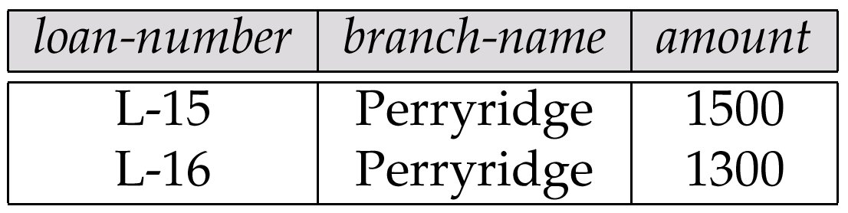
Result of σ _{branch-name = “Perryridge”} (loan)

Slide 47
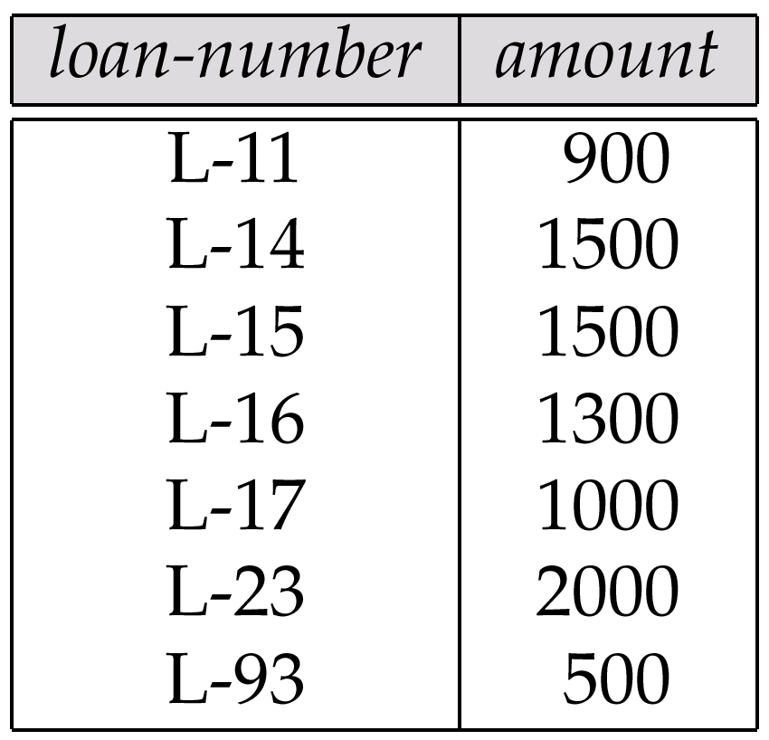
Loan Number and the Amount of the Loan

Slide 48
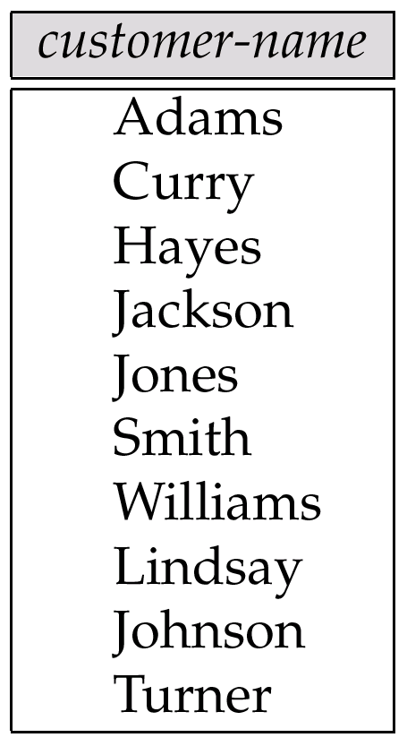
Names of All Customers Who Have Either a Loan or an Account

Slide 49
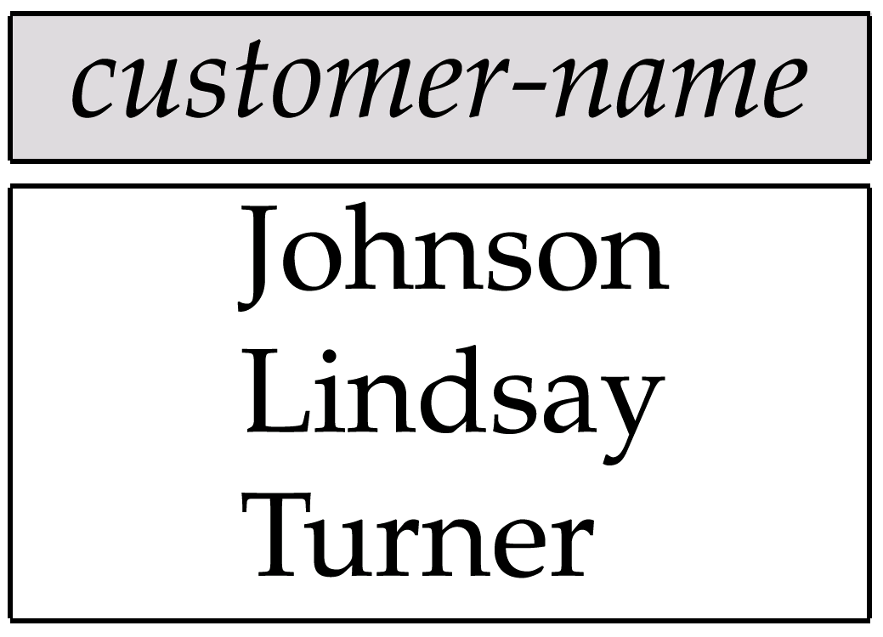
Customers With An Account But No Loan

Slide 50
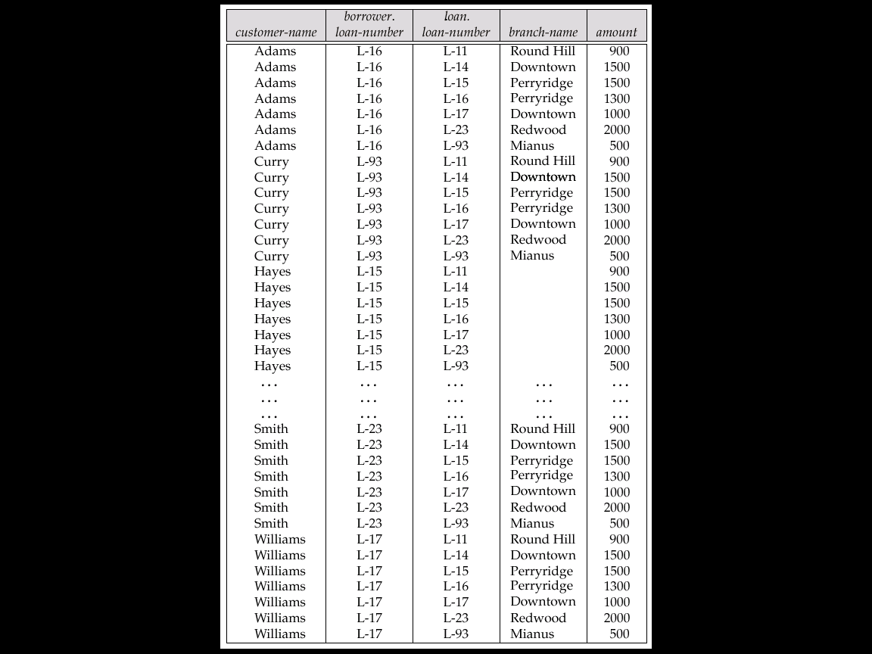
Result of borrower × loan

Slide 51
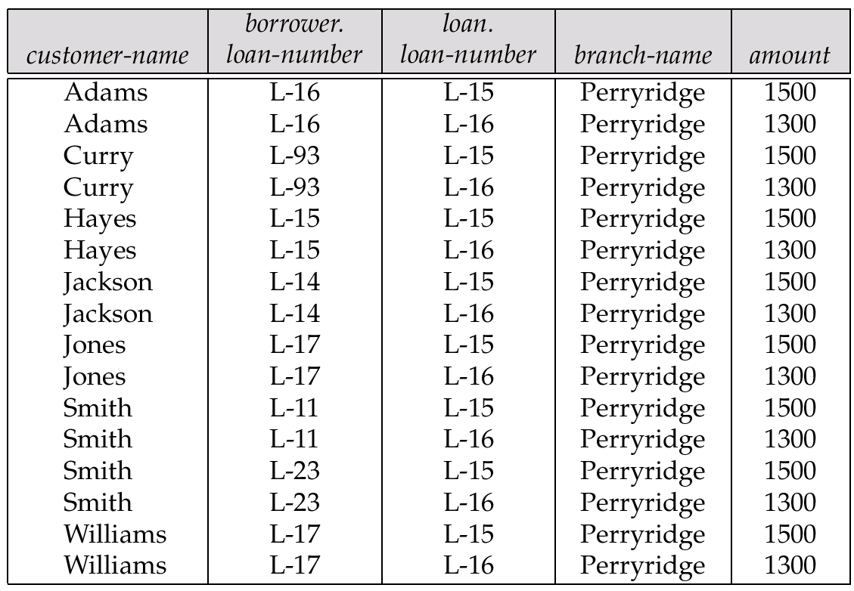
Result of σ _{branch-name = “Perryridge”} (borrower × loan)

Slide 52
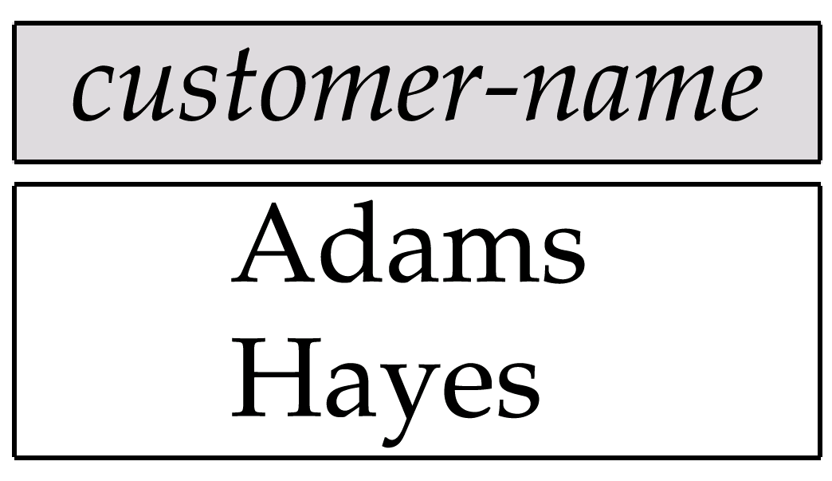
Result of Π_{customer-name}

Slide 53
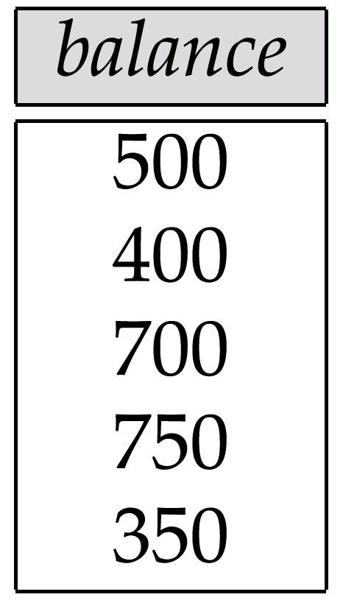
Result of the Subexpression

Slide 54
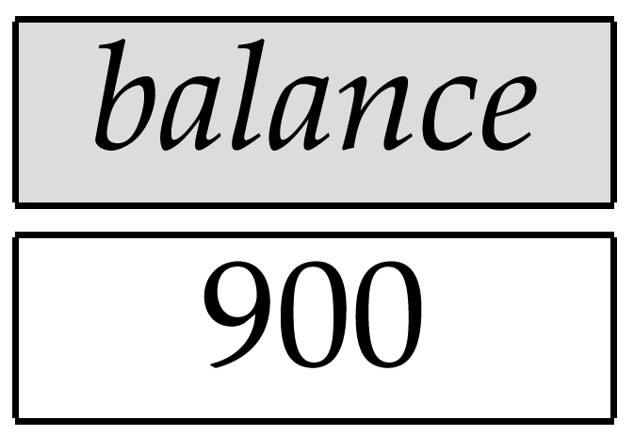
Largest Account Balance in the Bank

Slide 55
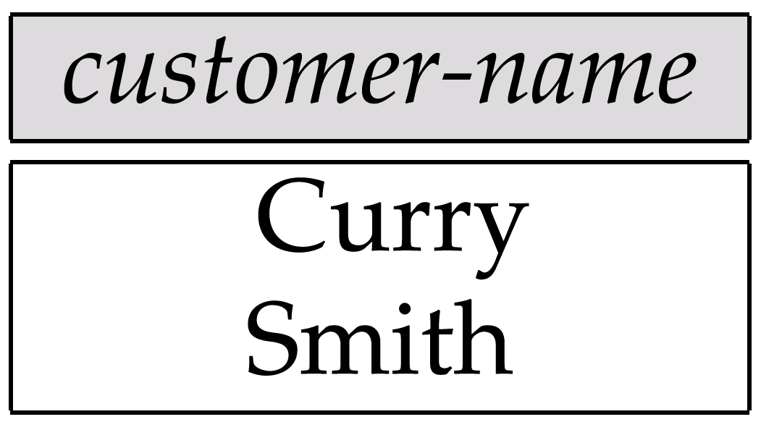
Customers Who Live on the Same Street and In the Same City as Smith

Slide 56
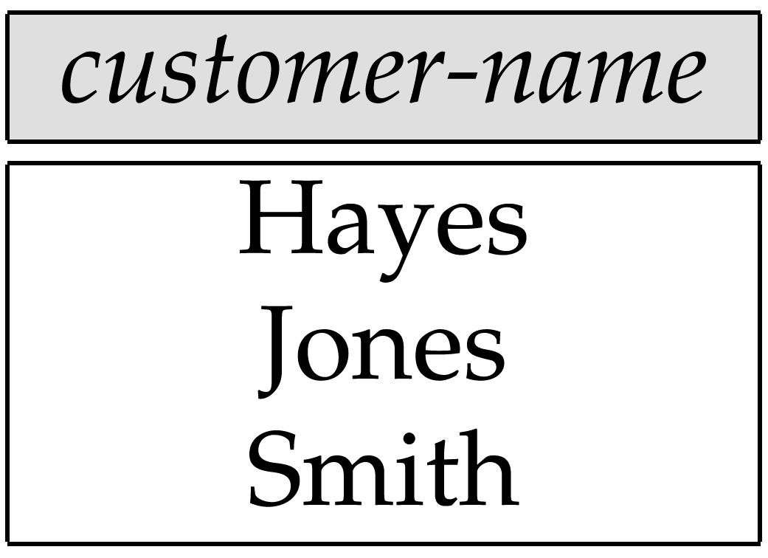
Customers With Both an Account and a Loan at the Bank

Slide 57
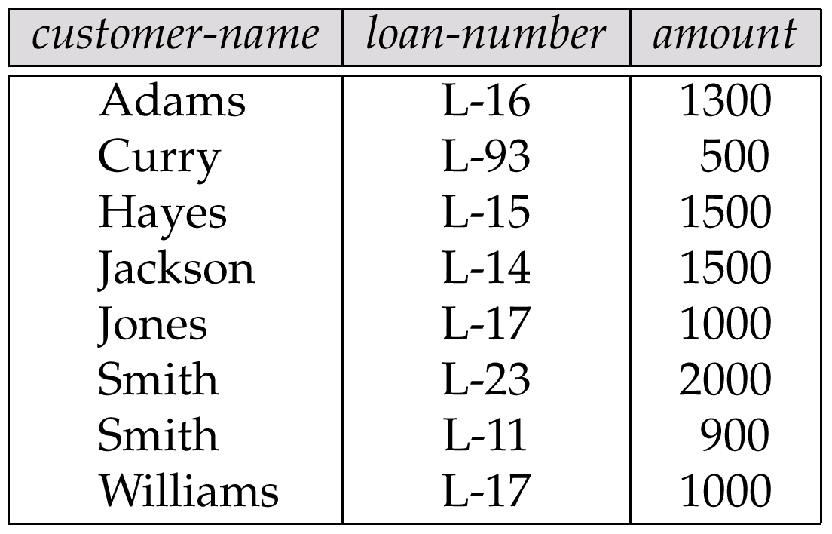
Result of Πcustomer-name, loan-number, amount (borrower loan)

Slide 58
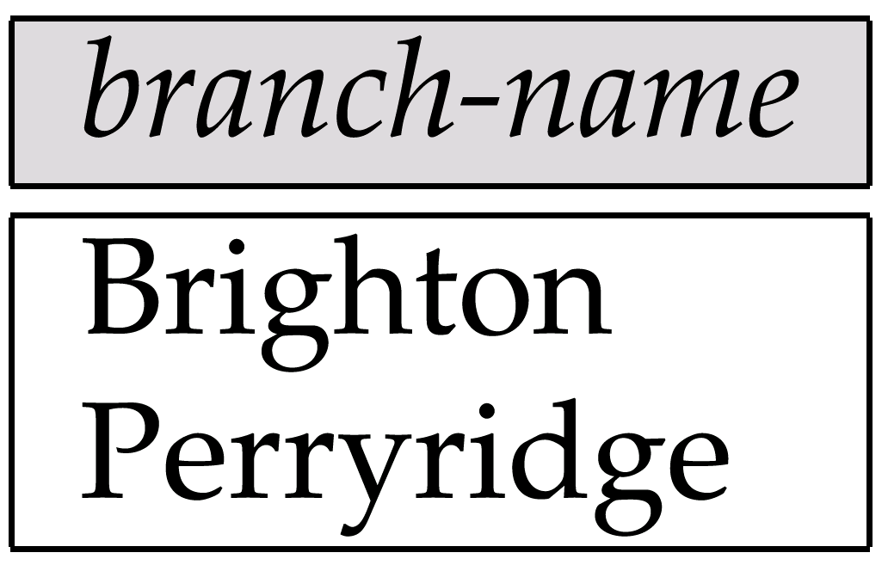
Result of Π_{branch-name}(σ_{customer-city = “Harrison”}(customer account depositor))

Slide 59
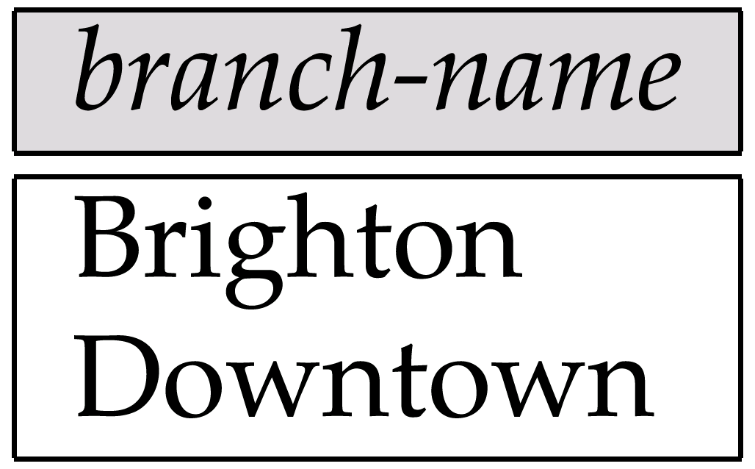
Result of Π_{branch-name}(σ_{branch-city =} “Brooklyn”^{(branch))}

Slide 60
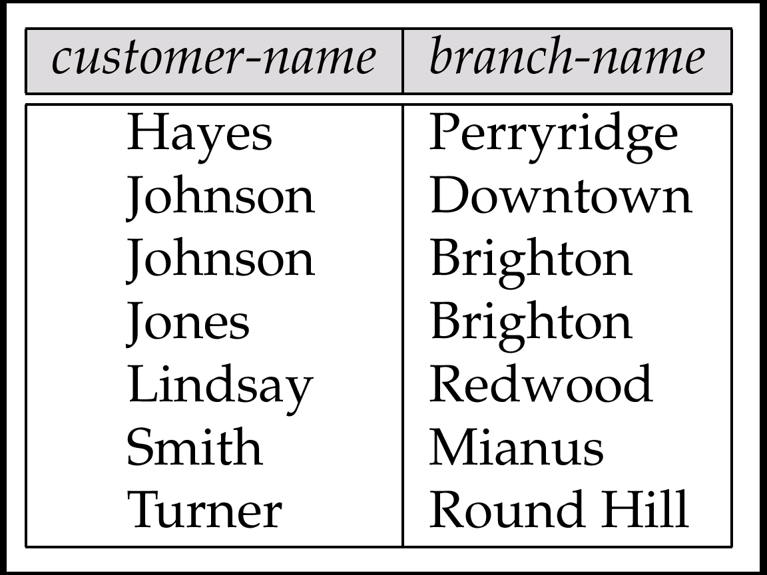
Result of Π_{customer-name, branch-name}(depositor account)

Slide 61
The credit-info Relation

Slide 62
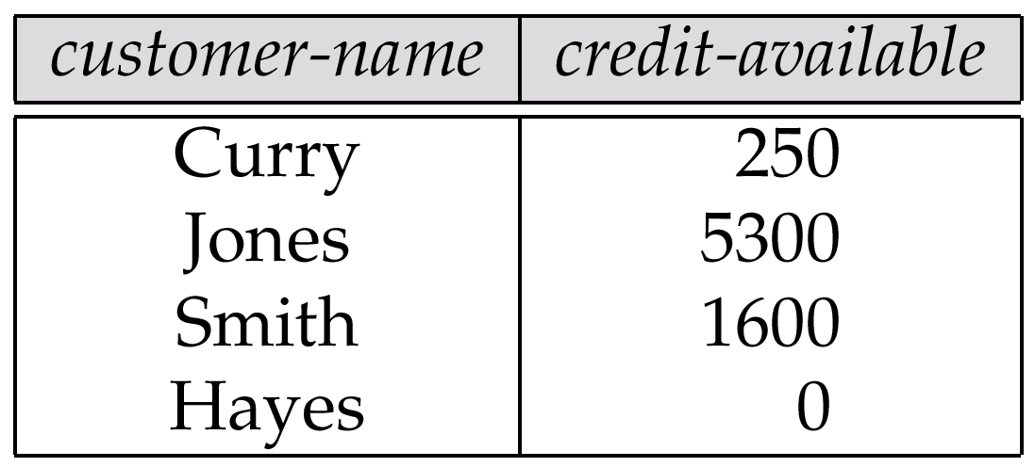
Result of Πcustomer-name, (limit – credit-balance) as credit-available(credit-info).

Slide 63
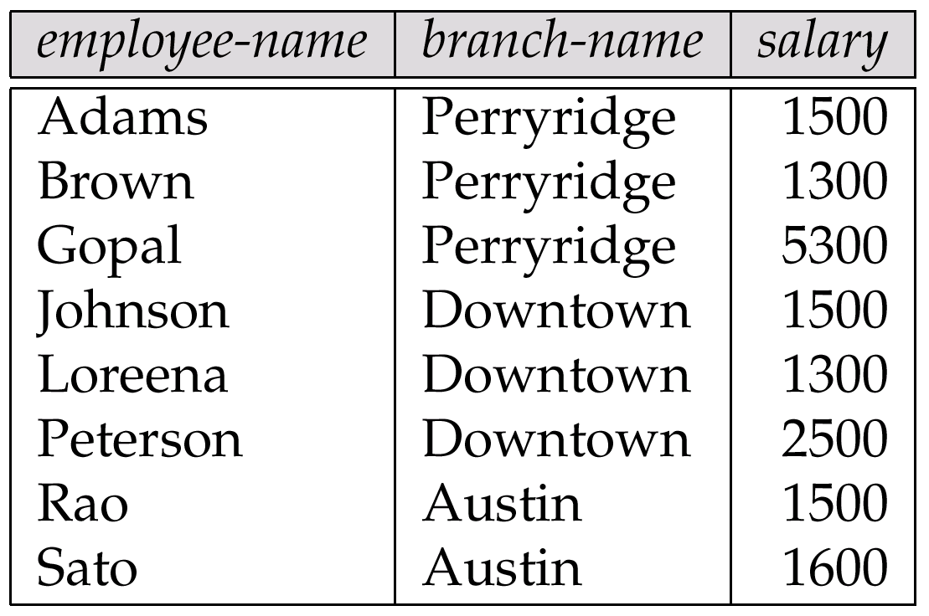
The pt-works Relation

Slide 64
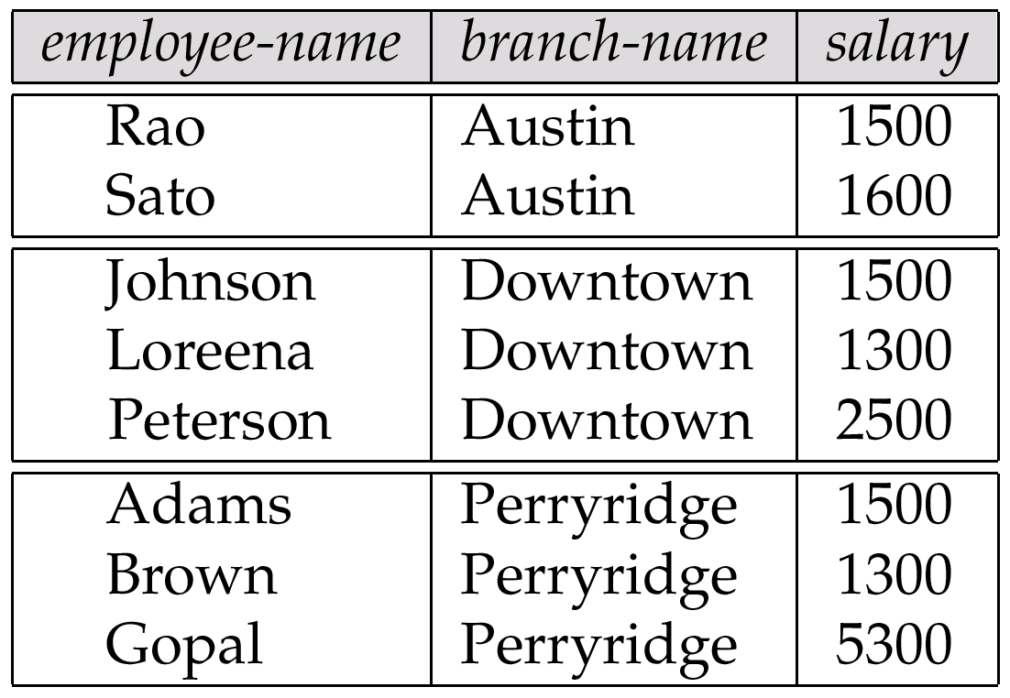
The pt-works Relation After Grouping

Slide 65
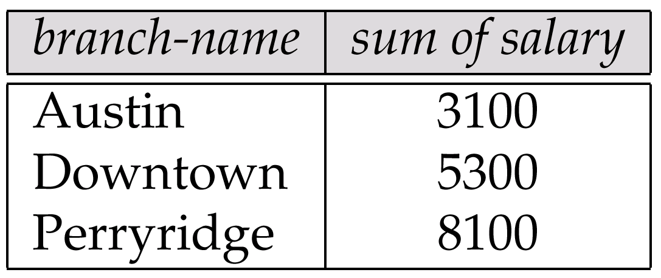
Result of _{branch-name} ς _{sum(salary)} (pt-works)

Slide 66
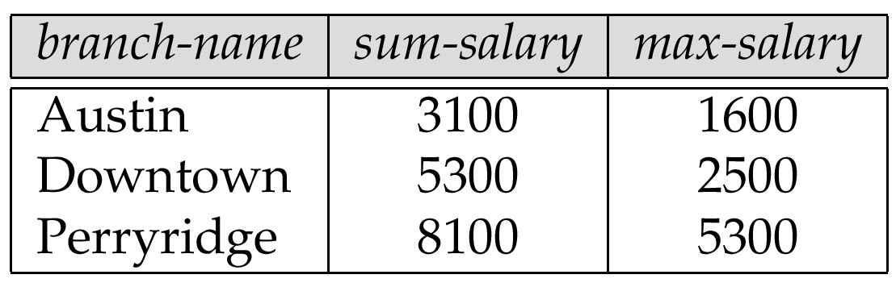
Result of _{branch-name} ς sum salary, max(salary) as max-salary (pt-works)

Slide 67
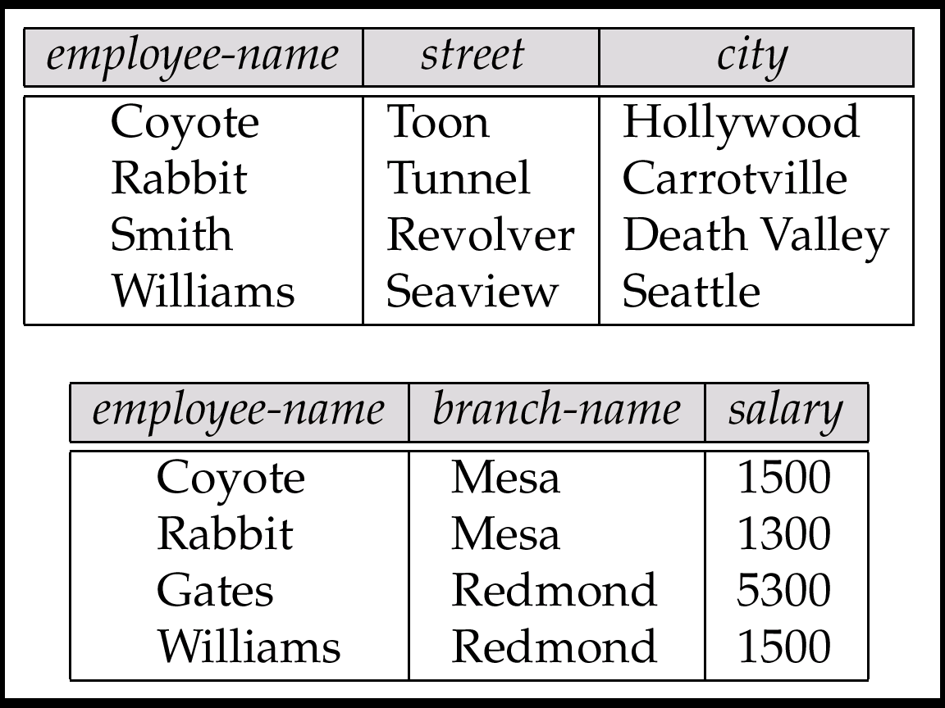
The employee and ft-works Relations

Slide 68
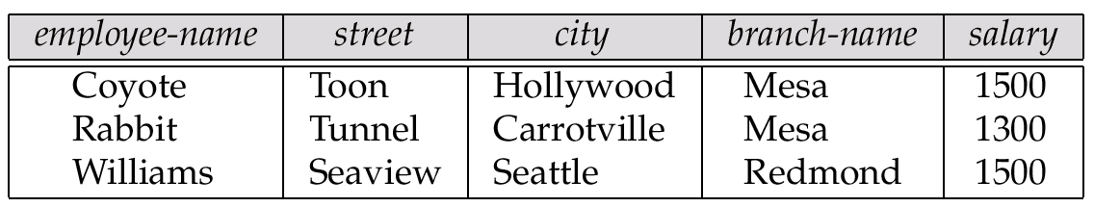
The Result of employee ft-works

Slide 69
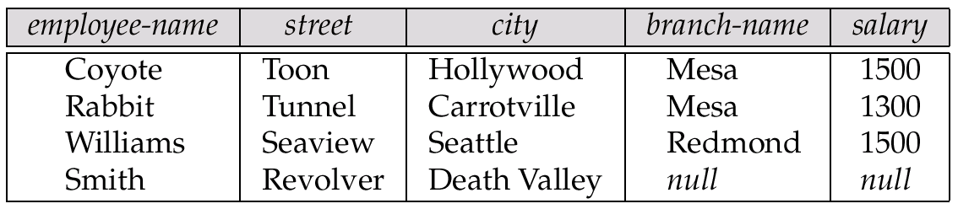
The Result of employee ft-works

Slide 70
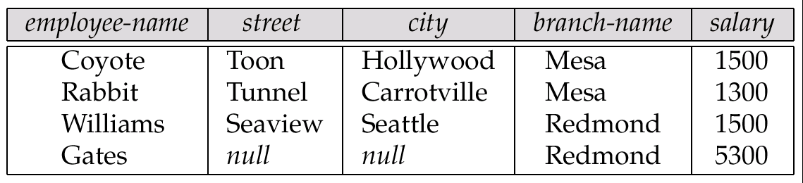
Result of employee ft-works

Slide 71
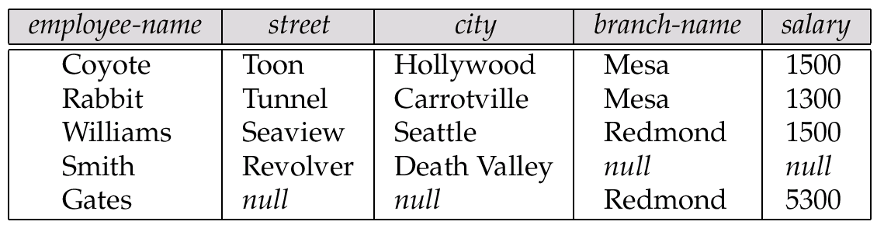
Result of employee ft-works

Slide 72
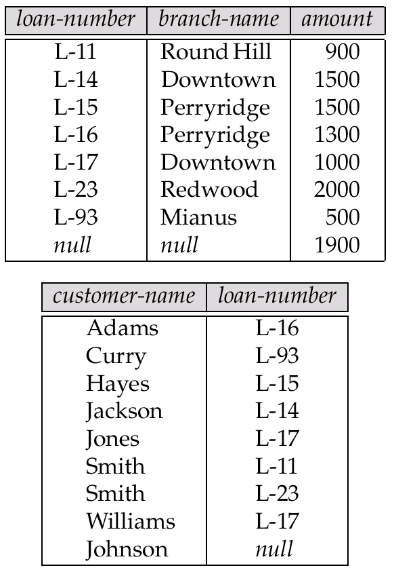
Tuples Inserted Into loan and borrower

Slide 73

Names of All Customers Who Have a Loan at the Perryridge Branch

Slide 74
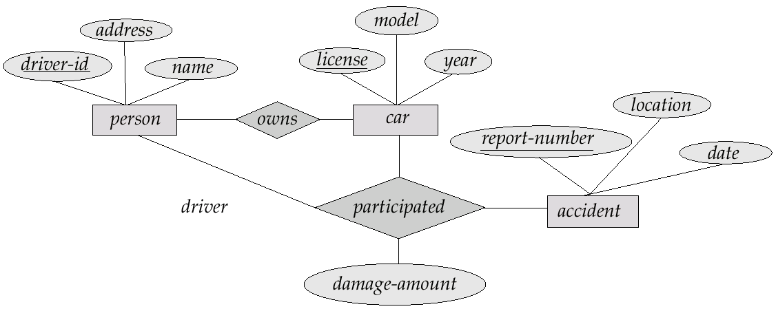
E-R Diagram

Slide 75

The branch Relation

Slide 76

The loan Relation

Slide 77

The borrower Relation

